Slide 1
Introduction to Multi-Agent Reinforcement Learning
Prof. Dr. Holger Giese (holger.giese@hpi.uni-potsdam.de)
Christian Medeiros Adriano (christian.adriano@hpi.de) - “Chris”

Slide 2
sources
Shimon Whiteson - Multi-Agent RL- Video Lectures
https://www.youtube.com/watch?v=W_9kcQmaWjo
https://www.youtube.com/watch?v=EsCwDYtBZ8M
Shoham et al. 2007, If multi-agent learning is the answer, what is the question?
VDN Algorithm
QMIX algorithm
Rashid, T., et al., 2018, QMIX: Monotonic Value Function Factorisation for Deep Multi-Agent Reinforcement Learning - http://proceedings.mlr.press/v80/rashid18a/rashid18a.pdf
Rashid, T., et al., 2020, Weighted QMIX: Expanding Monotonic Value Function Factorisation for Deep Multi-Agent Reinforcement Learning

Slide 3
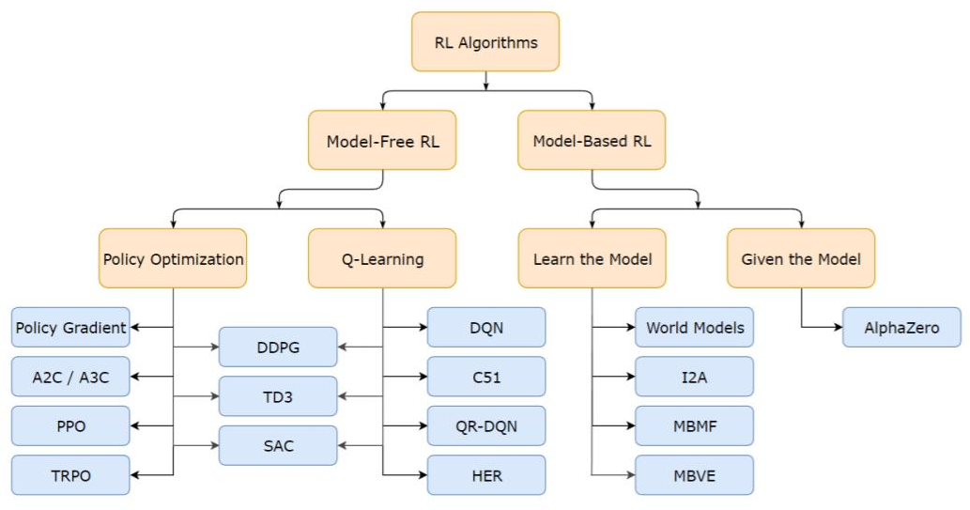
Brief Taxonomy of RL Methods

Slide 4
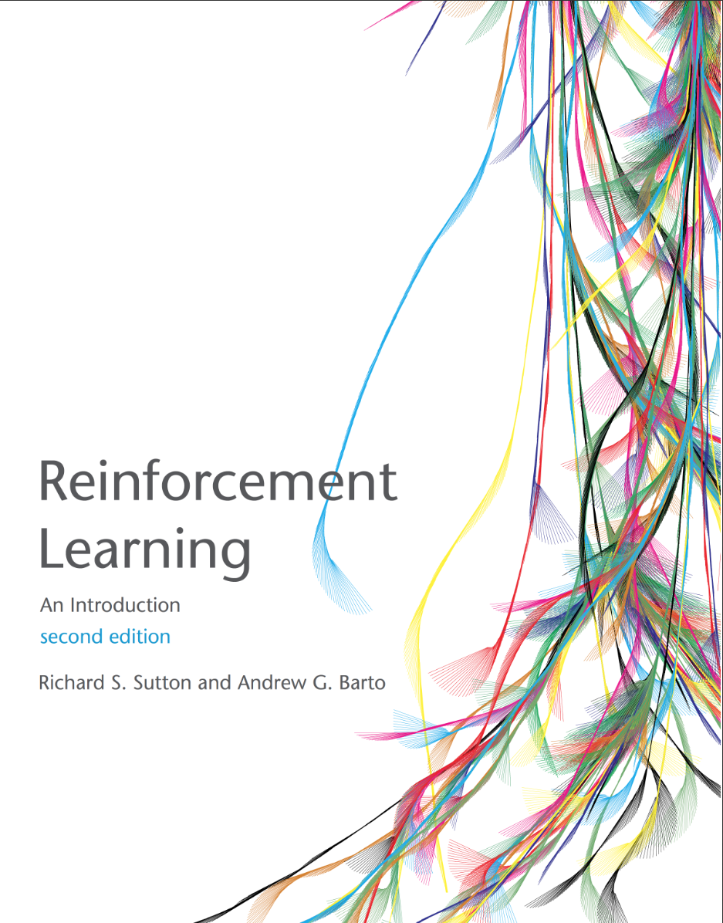
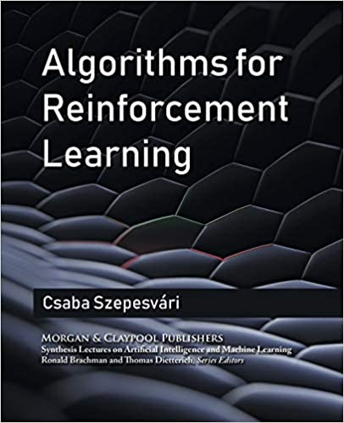

Resources used
Sutton, R. S., & Barto, A. G. (2015). Reinforcement learning: An introduction. MIT press. http://richsutton.com
Csaba Szepesvári (2010). Algorithms for reinforcement learning Morgan and Claypool. https://sites.ualberta.ca/~szepesva/rlbook.html
Lectures at UCL from DeepMind Research Scientists:
David Silver, 2015, https://www.davidsilver.uk/wp-content/uploads/2020/03/MC-TD.pdf
Hado Van Hansselt, 2018 https://www.youtube.com/watch?v=nnxHlg-2WgA&list=PLqYmG7hTraZBKeNJ-JE_eyJHZ7XgBoAyb&index=4
Notes:
https://www.microsoft.com/en-us/research/blog/exploring-the-fundamentals-of-multi-armed-bandits/

Slide 5
Basic concepts - Structure
Agent: external to the environment, take actions and has access to external states
Environment: constrains the agent, has hidden and visible states
State: visible information about the environment after an action was taken
Reward: value obtained after taking an action or being at a state
Action: taken by an agent, might cause a change in state
Goal: Maximize rewards by using an optimal policy
Policy: set of state action pairs
Markov property: we only need to know the current state to predict the next state

Slide 6

Agent and Environment Interaction
Action
Agent
Environment
State
Reward
Agent’s Goal: Maximize its reward
Our Goal: Discover a strategy that allows the agent to achieve its goal under various circumstances
Search, Estimate, Learn
Policy = $π(S,A)$
knowlege about the environment

Slide 7
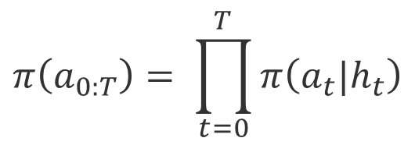
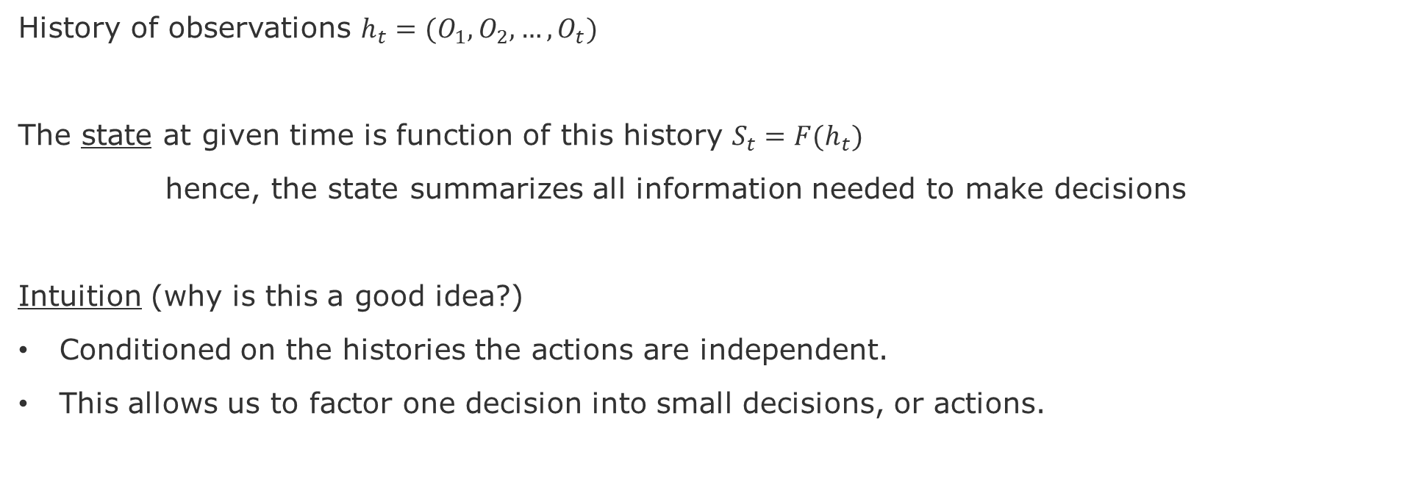
State
History of observations $h_{t}=(O_{1},O_{2}, …,O_{t})$
The state at given time is function of this history $S_{t}=F(h_{t})$
hence, the state summarizes all information needed to make decisions
Intuition (why is this a good idea?)
Conditioned on the histories the actions are independent.
This allows us to factor one decision into small decisions, or actions.
$$π\left(a_{0:T}\right)= \prod_{t=0}^{T}{π\left(a_{t}|h_{t}\right)}$$

Slide 8
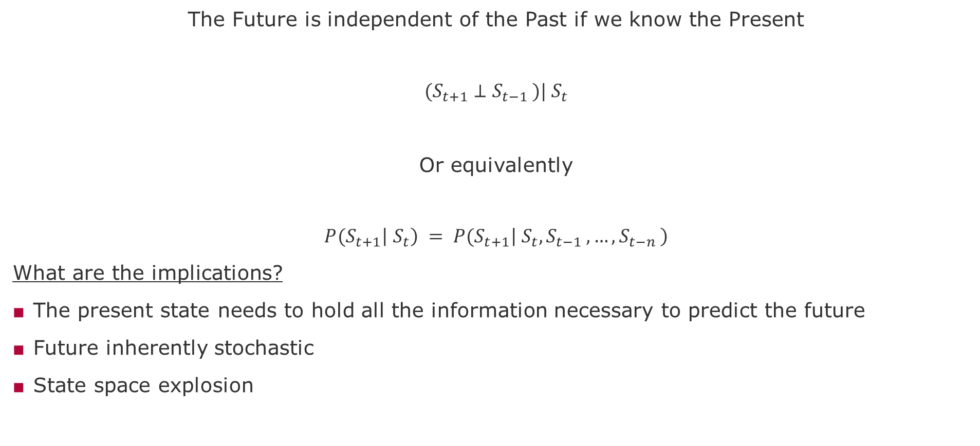
Markov Property
The Future is independent of the Past if we know the Present
$${(S}_{t+1} ⊥S_{t−1 })|{ S}_{t}$$
Or equivalently
$${P(S}_{t+1}\left|{ S}_{t}\right) = {P(S}_{t+1}\left|{ S}_{t},S_{t−1 },…,S_{t−n }\right)$$
What are the implications?
The present state needs to hold all the information necessary to predict the future
Future inherently stochastic
State space explosion

Slide 9
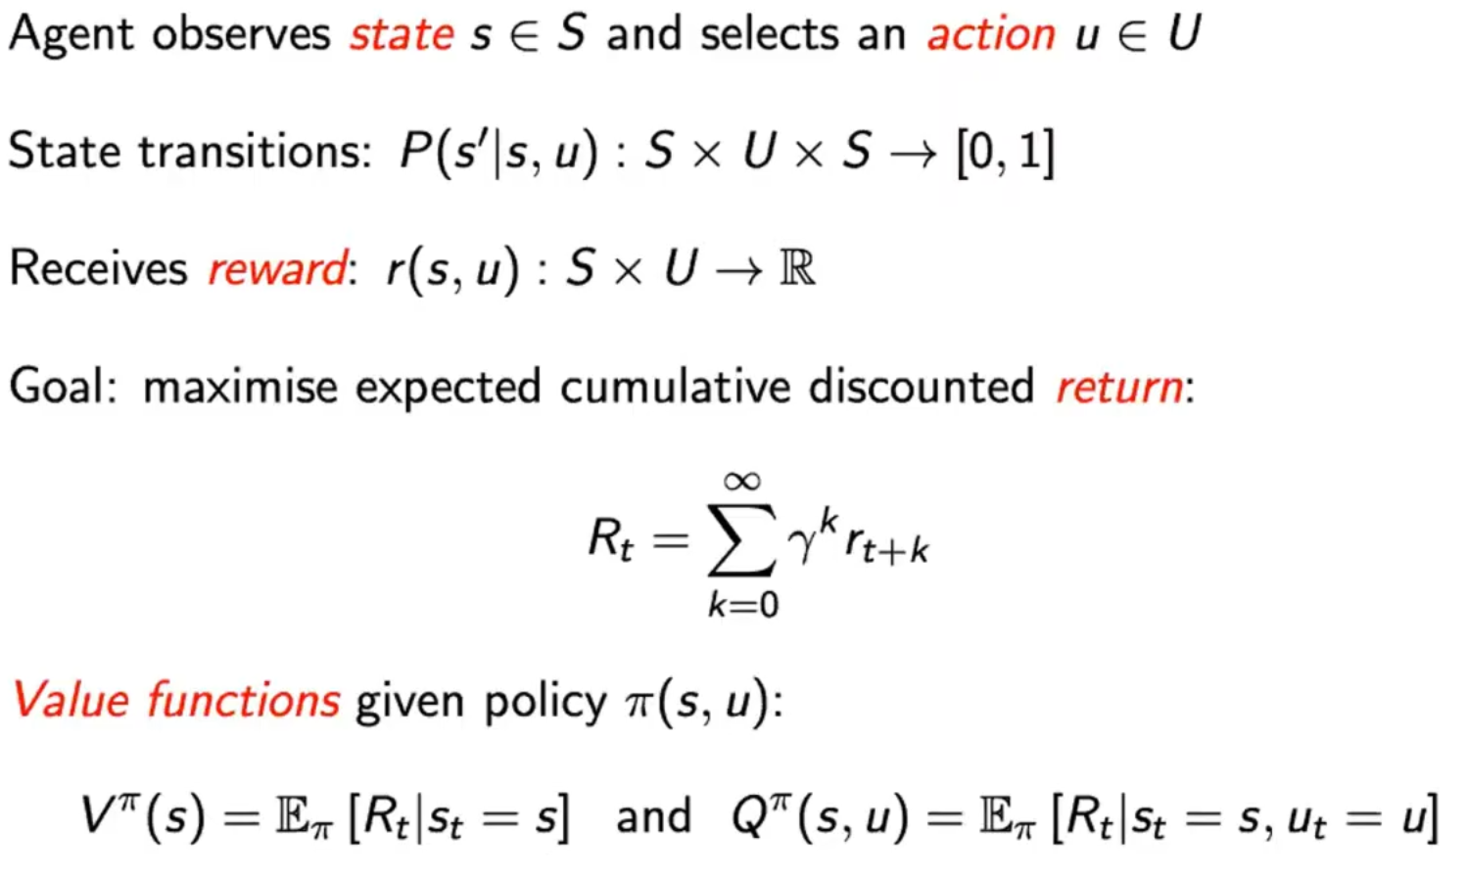
Markov Decision Process
[Whiteson 2020]
Notes:
Shimon Whiteson - Multi-Agent RL- Video Lectures
https://www.youtube.com/watch?v=W_9kcQmaWjo
https://www.youtube.com/watch?v=EsCwDYtBZ8M

Slide 10
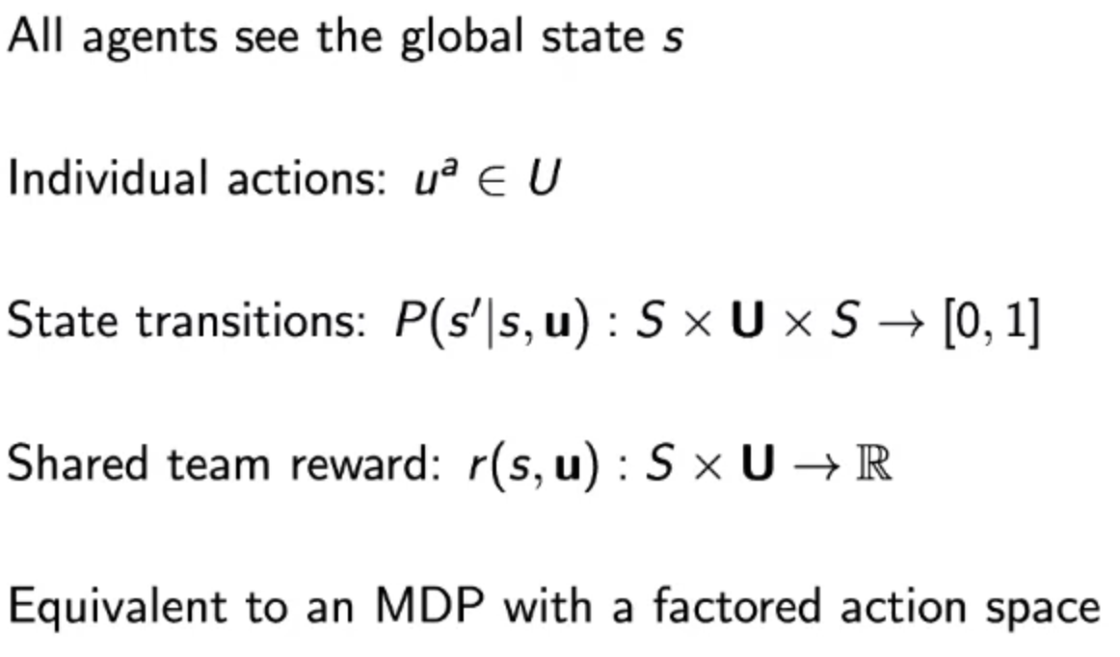
Multi-Agent MDP

Slide 11


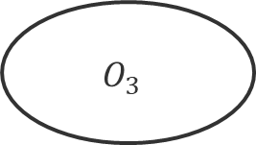
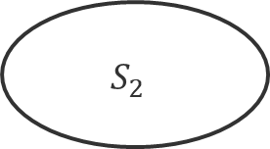


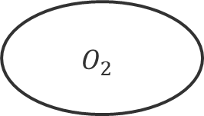
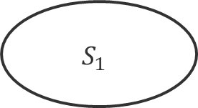
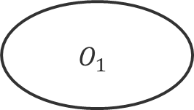





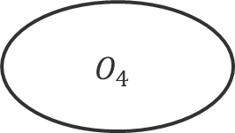


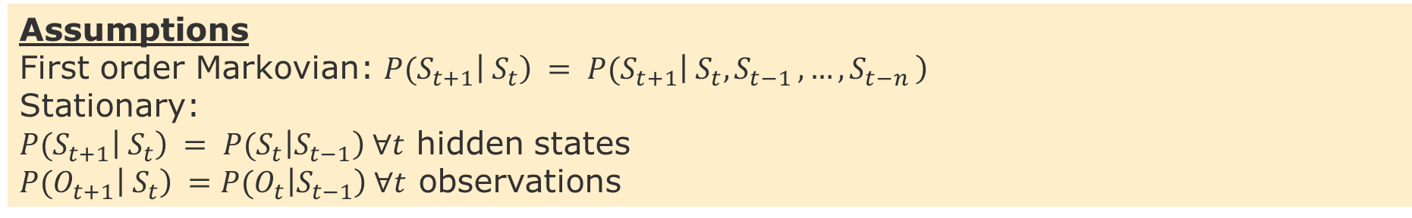
Hidden Markov Model - HMM
$$0.3$$
$$0.5$$
$$0.5$$
$$S_{1}$$
$$S_{3}$$
$$0.5$$
$$0.1$$
$$0.6$$
$$S_{4}$$
Hidden states
$$S_{2}$$
$$0.3$$
$$1.0$$
End
$$0.2$$
$$O_{1}$$
$$O_{2}$$
$$O_{3}$$
$$O_{4}$$
Observations
Assumptions
First order Markovian: ${P(S}_{t+1}\left|{ S}_{t}\right) = {P(S}_{t+1}\left|{ S}_{t},S_{t−1 },…,S_{t−n }\right)$
Stationary:
${P(S}_{t+1}\left|{ S}_{t}\right) = {P(S}_{t}\left|S_{t−1}\right) ∀t$ hidden states
${P(O}_{t+1}\left|{ S}_{t}\right) ={P(O}_{t}\left|S_{t−1}\right) ∀t$ observations

Slide 12


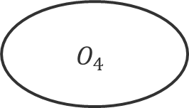





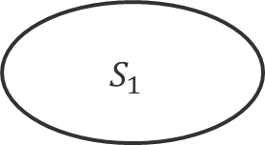
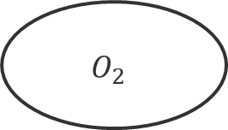




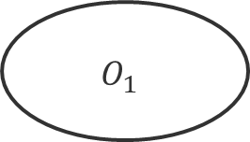





Partial Observable Markov Decision Process - POMDP
$$0.3$$
$$0.5$$
$$0.5$$
$$S_{1}$$
$$S_{3}$$
$$0.5$$
$$0.1$$
$$0.6$$
$$S_{4}$$
Hidden states
$$S_{2}$$
$$0.3$$
$$1.0$$
End
$$0.2$$
$$O_{1}$$
$$O_{2}$$
$$O_{3}$$
$$O_{4}$$
$$R_{1}$$
Observations
$$A_{1}$$
$$A_{2}$$
Actions and Rewards
While in the HMM we are passively observing and trying to infer the real state, in the POMDP we have partial control over the state transitions through the actions, whose effects produces a signal (reward Ri) for future actions.

Slide 13
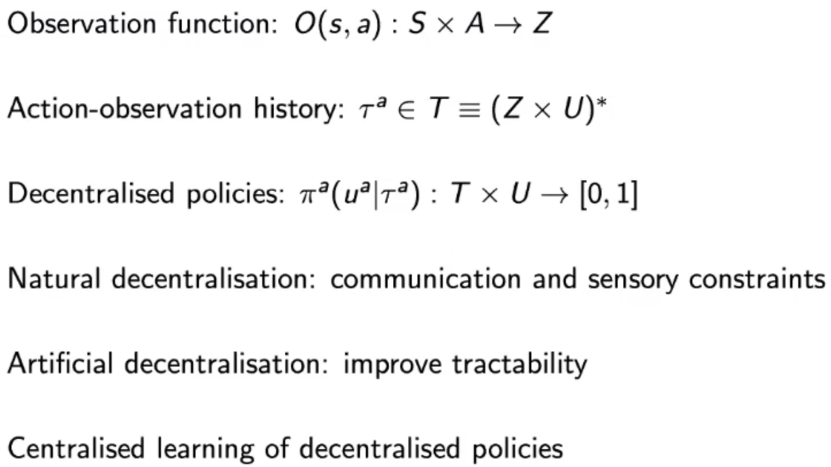
Decentralized POMDP
Approach
Centralized Training
Decentralized Control (Policy Execution)

Slide 14
Explore versus Exploit Trade-off
Maximizing performance requires collecting reward
In a single-agent setting this implies exploiting observations
However,
In a Dec-POMDP agents cannot explicitly communicate
Coordination requires some predictability = all agents stick to the plan
This means that agents might need to ignore private (local) knowledge
How to balance between coordination (global knowledge) and exploration (local knowledge)?
When does the benefit of exploiting private

Slide 15
MARL Algorithms / Architectures

Slide 16
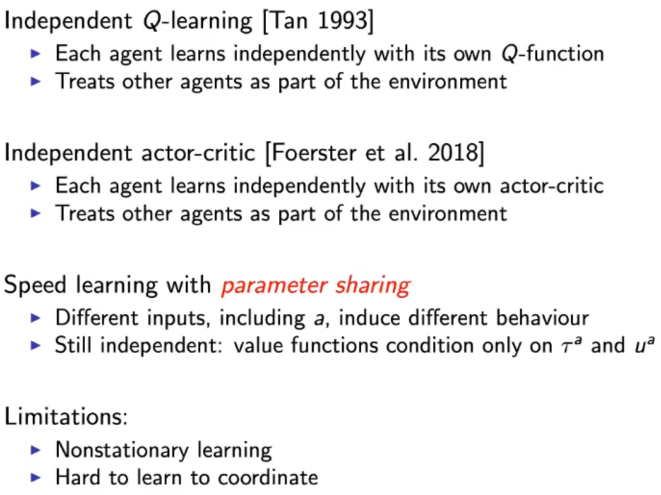
Naïve Approach: treat others as part of the environment
Prevents us from
studying Robustness

Slide 17
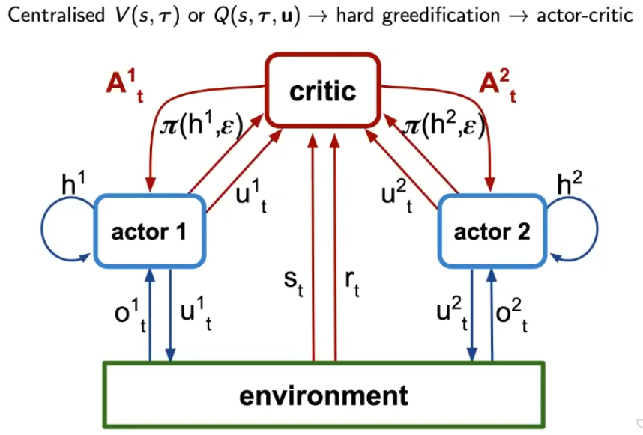
Centralized Critics [Lowe 2017][Foerster 2018]
Caveat:
Centralized makes harder to developed decentralized policies
Solution: Factorized the Value Function

Slide 18
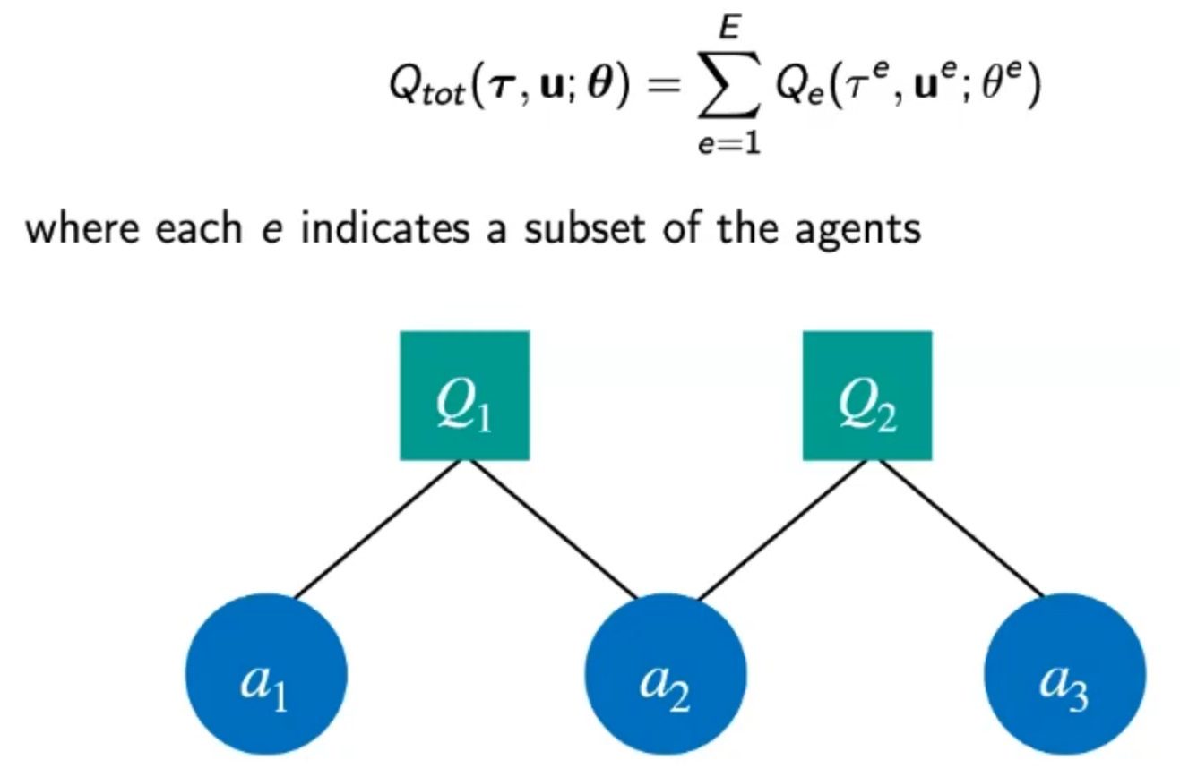
Factored Value Functions [Gestrin 2003]

Slide 19
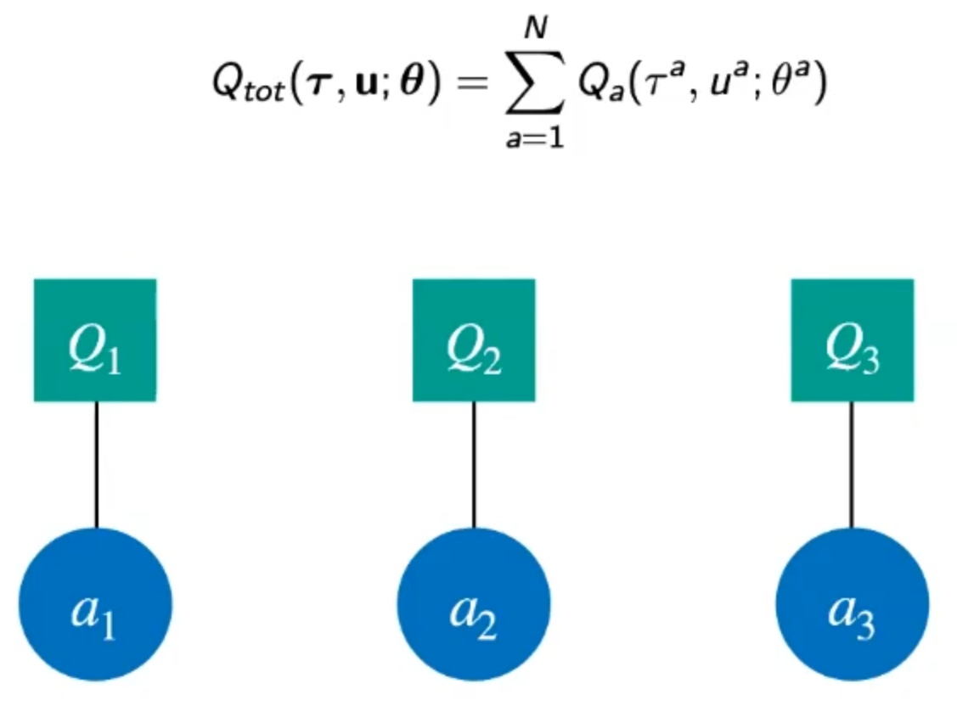
VDN – Value Decomposition Network [Sunehag 2017]
One Factorization per Agent
Advantage:
Allows to use Q-Learning instead of Actor-Critic
Notes:
https://youtu.be/W_9kcQmaWjo?t=2061

Slide 20
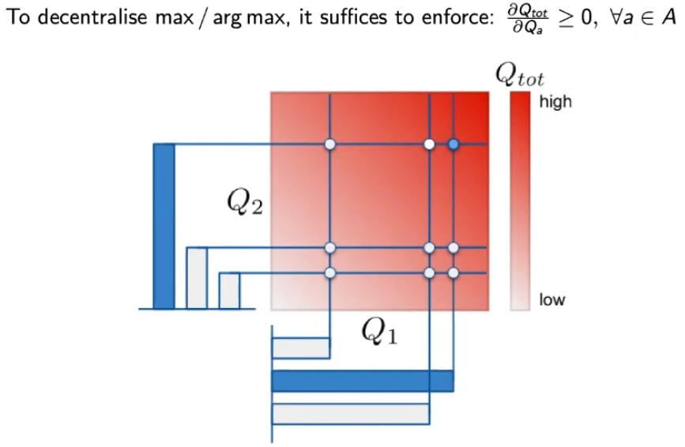
QMix

Slide 21
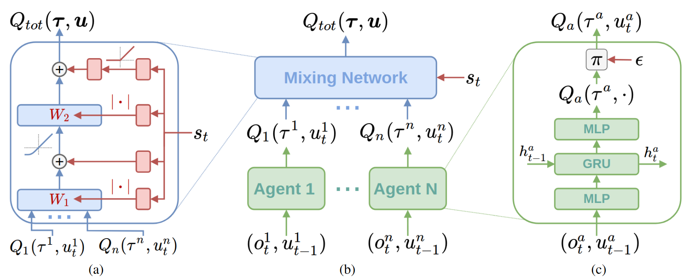
Qmix [Rashid 2018] [Rashid 2020]
Mixing network structure. In red are the hypernetworks that produce the weights and biases for mixing network layers shown in blue.
(b) The overall QMIX architecture.
(c) Agent network structure
Notes:
Rashid, T., et al., 2018, QMIX: Monotonic Value Function Factorisation for Deep Multi-Agent

Slide 22
End

